Slide 1
Building Science Gateways Using Gadgets and OpenSocial
Zhenhua Guo, Raminder Singh, Marlon Pierce
Pervasive Technology Institute at Indiana University
{zhguo, ramifnu, marpierc}@indiana.edu
Thanks also: Yan Liu, Carol Song, David Braun, Roland Mai

Slide 2
What Is a Science Gateway?
A Science Gateway is a Web-based environment for accessing supercomputers, mass storage systems, scientific instruments, data collections, and other scientific resources.
Most gateways are user interfaces to scientific applications and data sets
Computational chemistry, climate modeling, weather modeling, drug discovery, gene sequencing, etc.
In US, gateways primarily associated with the NSF TeraGrid Science Gateway program.
List of gateways: https://www.teragrid.org/web/science-gateways/gateway_list
Nancy Wilkins-Diehr directs this effort
Example European activities: http://agenda.ct.infn.it/conferenceDisplay.py?confId=347

Slide 3
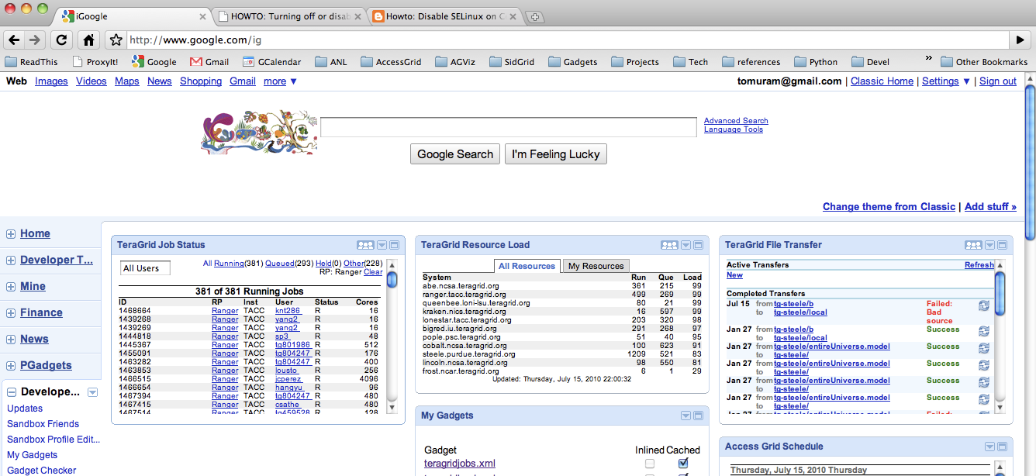
UC TeraGrid Gadgets
Courtesy Tom Uram, University of Chicago

Slide 4
Purdue TeraGrid Gadgets

Slide 5
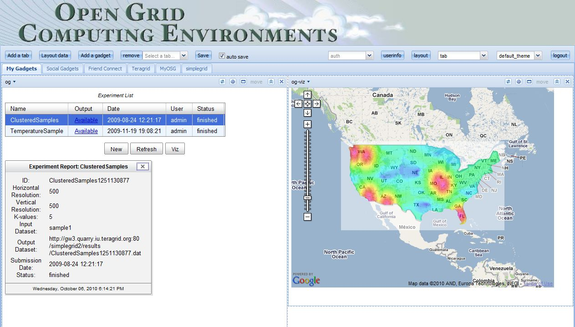
SimpleGrid Gadgets
Yan Liu, UIUC

Slide 6
About OGCE
http://www.collab-ogce.org
http://collab-ogce.blogspot.com
http://twitter.com/ogceproject

Slide 7
Open Gateway Computing Environments
The OGCE team develops software for building secure, Web-based Science Gateways
Chemistry, Bioinformatics, Biophysics, Environmental Sciences
OGCE is funded by the National Science Foundation’s Software Development for Cyberinfrastructure (SDCI) program.

Slide 8
OGCE Software
Name | Description
OGCE Gadget Container | An OpenSocial and Google gadget-compatible Web container for running Web gadgets.
GFAC | A Web service for generating, securely invoking, and managing the lifecycle of scientific applications on Grids and Clouds
Workflow Tools | Composer (XBaya), enactment engines, event system, and service registry to support scientific workflows on Grids and Clouds.
Gadgets and Gadget Building Tools | Tools for building secure Google-gadget based Science Gateways.

Slide 9
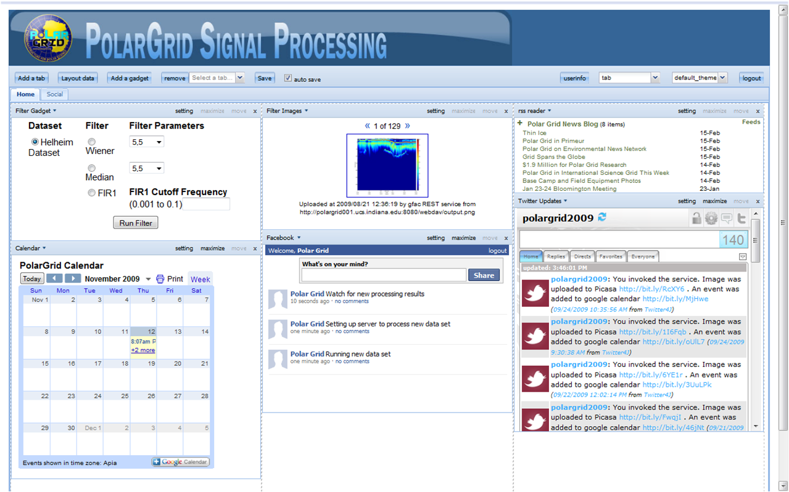
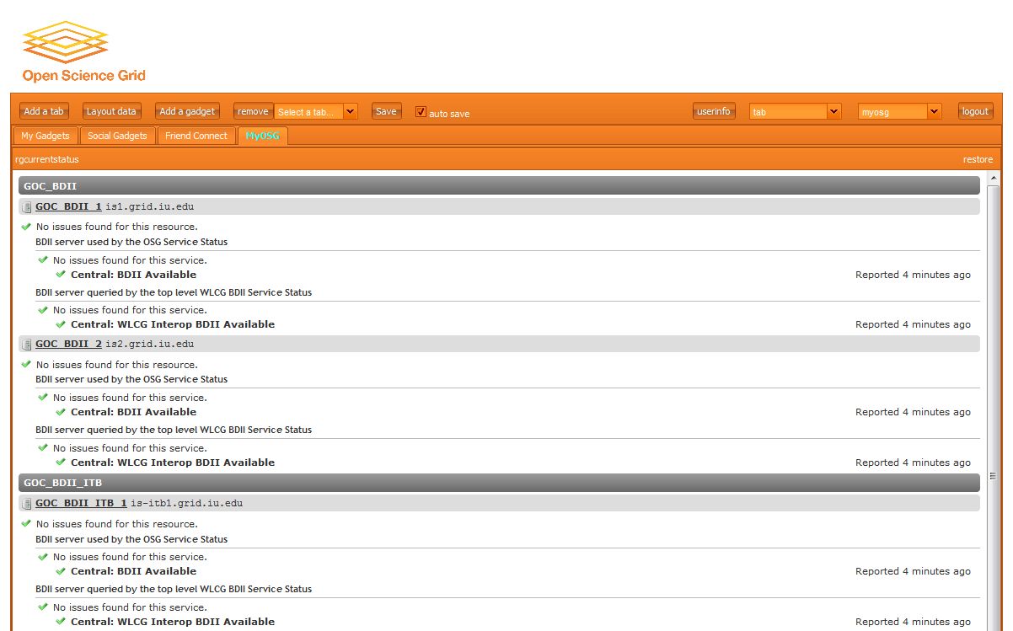
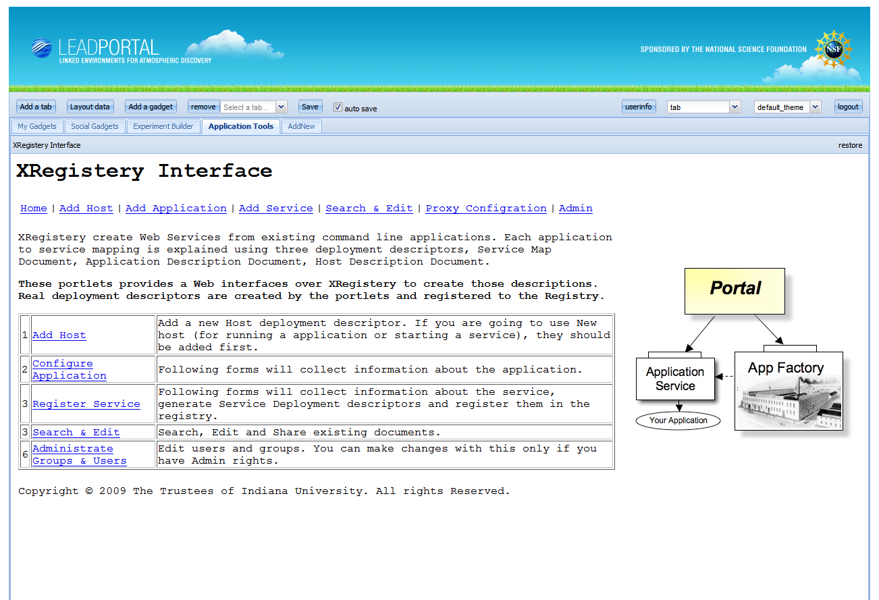
Google Gadget-Based Science Gateways
PolarGrid
MyOSG
LEAD

Slide 10
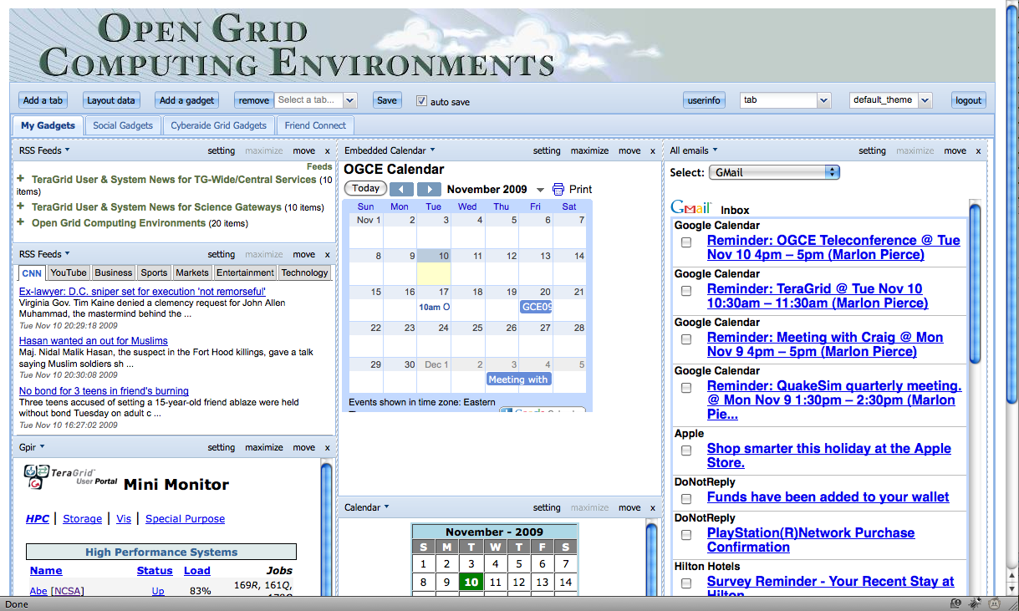
The OGCE Gadget Container allows you to build portals out of public and private Google Open Social gadgets. Supports HTTPS. Downloadable, packaged software.

Slide 11
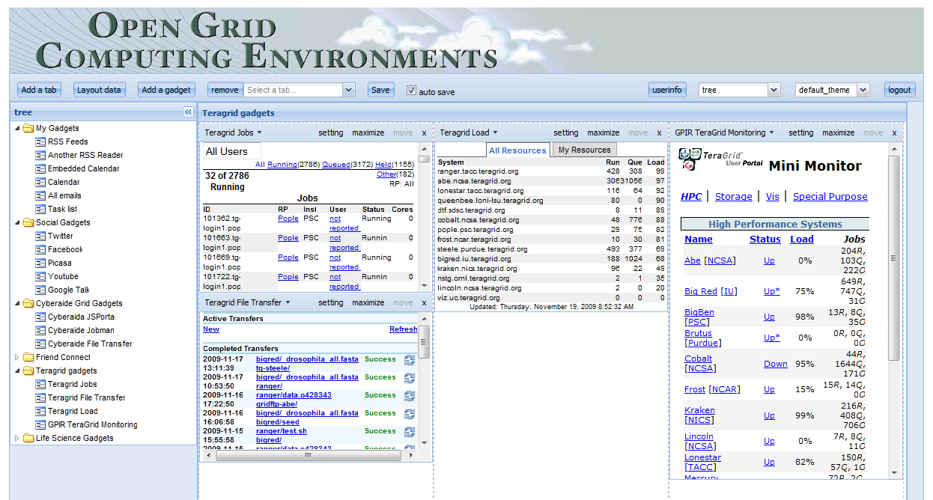
Users can switch between tabbed view (default) and tree view (shown)

Slide 12
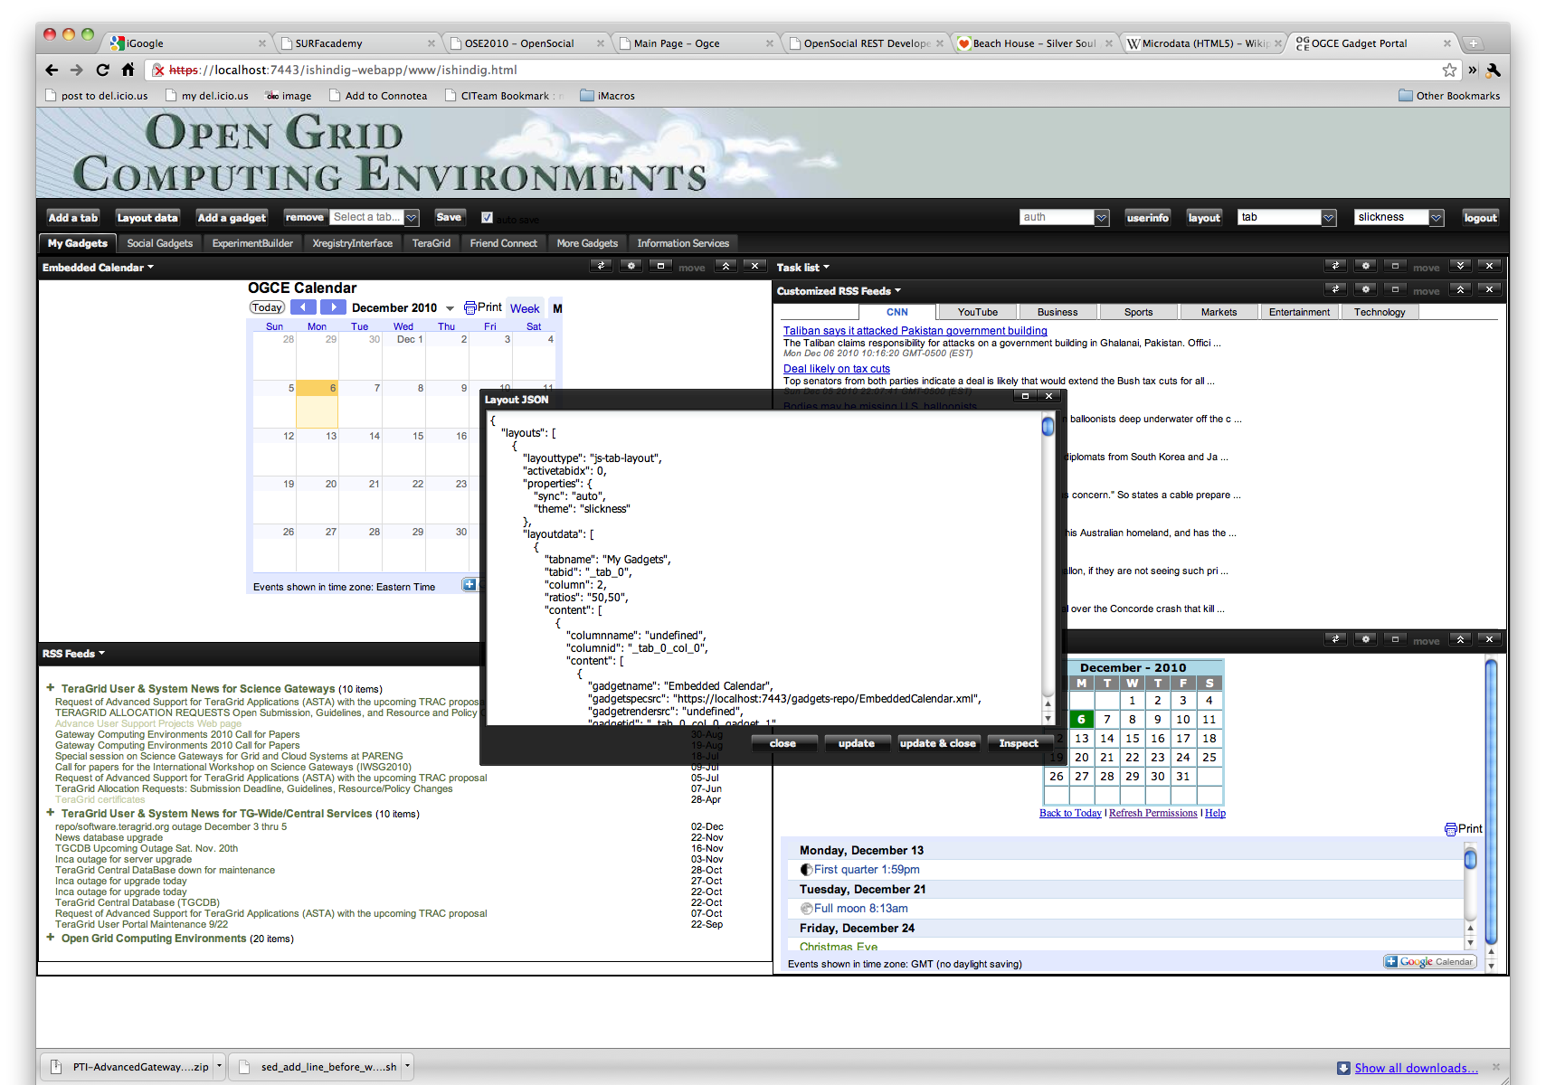
Layouts can be two or three columns. Color schemes can be dynamically changed. Layouts are encoded in JSON, can be edited directly, can be accessed by REST API.

Slide 13
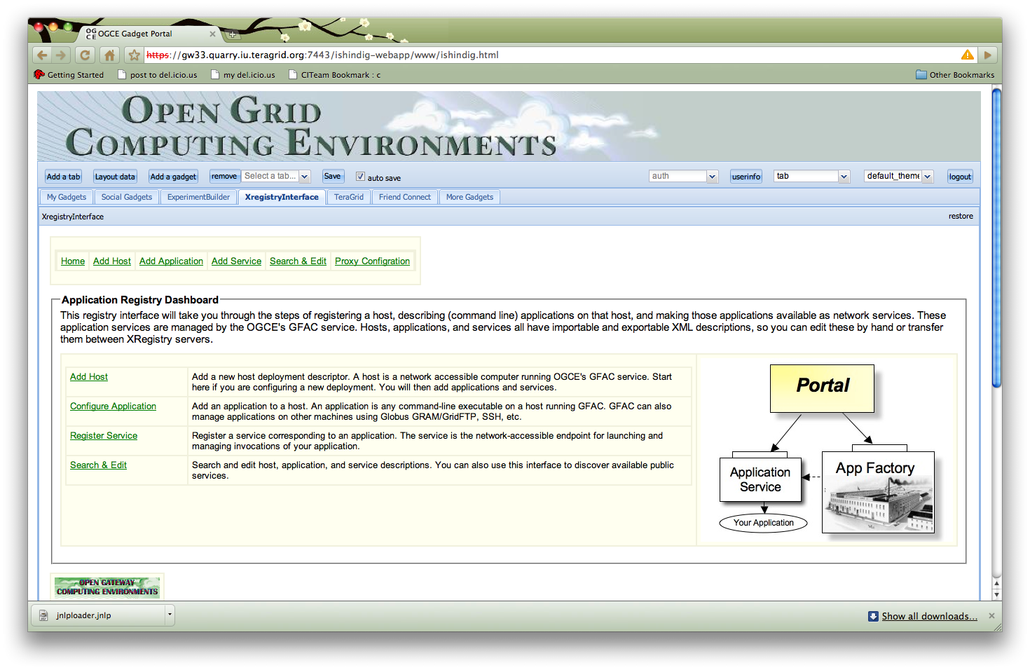
The OGCE Application Registry gadget allows users to interactively register hosts and applications that are dynamically wrapped as Web services. Default canvas view.

Slide 14
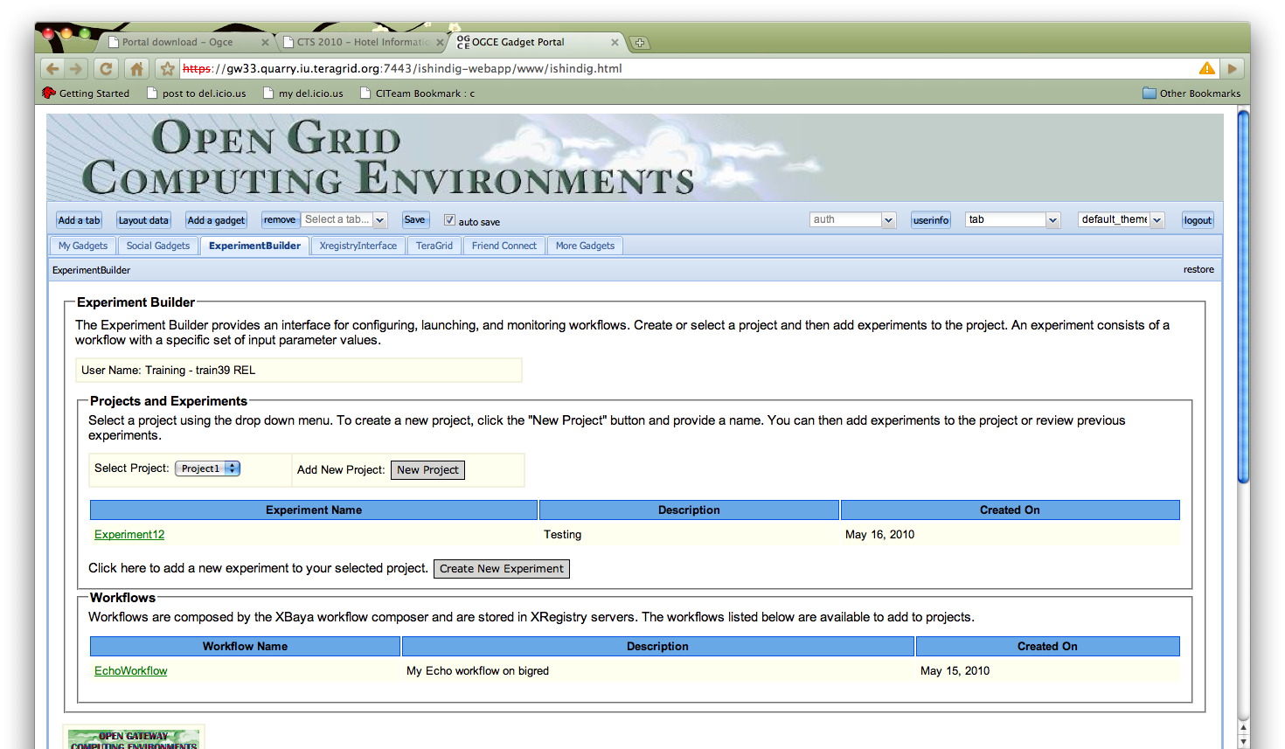
The OGCE Experiment Builder gadget allows users to create projects and experiments out of previously composed workflows.

Slide 15
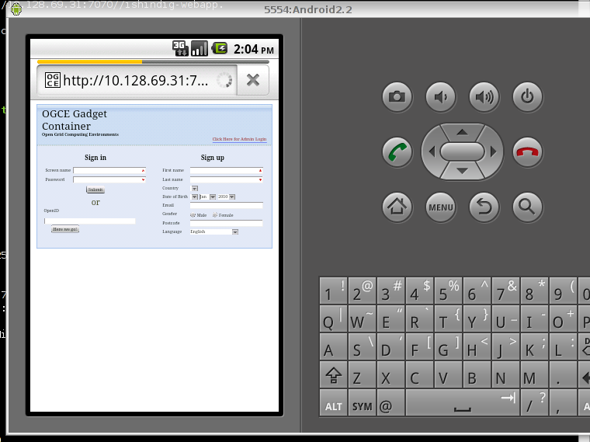
Mobile Support
Gadget Container is built with HTML, JavaScript and CSS. Works in both iPhone and Android native browsers with out modification.
Developing layout managers better suited to limited screen real estate.

Slide 16
OGCE Gadget Container Details

Slide 17
Why a Gadget Container?
TeraGrid community diversifying beyond Java portlets.
Need a common component model
Gadgets provide a more flexible development environment.
We wanted to develop portal software for Science Gateway gadgets.
Build on top of Shindig 2.0 for gadget rendering, social networking
Add layout, look-and-feel support, identify management, administration
Provide extended REST APIs: layouts, login, sign-up, etc
Meet Gateway requirements for security
End-to-end HTTPS, including remotely running “url” gadgets
X509 credential passing: in-memory and via REST to remote services
Simplify configuration, build, and deployment down to 1-2 steps
Open Source for supporting contributions and collaborations.

Slide 18
Feature Groups | Features
Look and Feel | Tabbed and Tree layout managers, 2 and 3 column layouts, default maximized views of gadgets, customizable color styling.
Security | Supports end-to-end SSL between browser, container, and gadgets; OpenID authentation; OAuth-secured gadgets; MyProxy logins; limited Grid credential sharing between gadgets; CILogon for InCommon login
Inter-Gadget Communication | Supports OpenAjax publish-subscribe style messaging between gadgets. Investigating PMRPC
REST Service API | Layouts, logins, sign-ups, user administration, user identification, and Grid credentials all accessible via REST service calls as well as the user interface.
Open Source Social Networking | All code is open source and builds on Apache Shindig 2.0.

Slide 19
Example Gadgets
Filter Gadget | User can select different parameters to run a filter to create image. Result image will be displayed on Google map.
Blog Gadget | To display Atom feeds from blog sites.
Picasa Gadget | Picasa gadget to display all the filter images with filter description.
Discussion Board | Google Friend Connect (GFC) gadget to discuss on certain topic.
FAQ Gadget | GFC gadget for Question/Answer. Moderator can always control the topics and can block people from the list.
Google Calendar | Calendar gadget to display public PolarGrid-specific activities and tasks.
Twitter Gadget | To read filter execution updates from twitter feeds.
Facebook Gadget | User can update status of task directly to Facebook from here.
Gateway Gadgets | Gadgets for registering applications, browsing workflows
General rule: don’t reinvent existing services.

Slide 20
Implementation Details
Gadget container server side implemented as Java web application.
Peer webapp to Shindig in the same Tomcat server. Our Maven installation process overrides ROOT with Shindig 2.0.
We don’t touch Shindig code except to customize configuration.
Needed to enable OAuth, for example: http://cglreport.zhenhua.info/2010/09/oauth-in-ogce-gadget-container.html
HTTPS authentication configured (including key generation in our build phase)
Client side built with Ext-JS JavaScript, OpenAJAX Hub libraries.
Gadgets are rendered with Shindig; we embed them as IFrames.
JAAS for login module.
We currently manage the user profiles ourselves.
GWT, YUI-based gadget support in progress
YUI: must tweak the YUI “make request” function.
GWT: CSS and JavaScript relative paths not handled correctly (“same origin” problems)

Slide 21
Shindig Issues
Need to understand impact of HTML5 and related stuff
Web messaging, drag and drop, client-side storage
Collaborators like to use their own JavaScript libraries, frameworks (YUI, GWT, PMRPC, jQuery, …) instead of OpenSocial Gadget libraries
Will have SOP problems when making AJAX calls, etc.
Many nice gadgets in iGoogle use non-standard or proprietary tags
Google Viz, Charts, etc.
Most gadgets are toys. No good Google docs, spreadsheet integration with gadgets.
To survive, OpenSocial needs a set of high quality, open source, portable, sustainable productivity, content management, document management, and related tools.

Slide 22
More Information
Demo Movies: See http://www.collab-ogce.org/ogce/index.php/Main_Page#What_Does_It_Do.3F
OGCE Web Site: http://www.collab-ogce.org
News Feed/Blog: http://collab-ogce.blogspot.com
Contact us:
ogce-discuss@googlegroups.com
http://groups.google.com/group/ogce-discuss/
Software Downloads: Software is available as tagged SVN releases from our SourceForge project.
http://sourceforge.net/projects/ogce/
See http://www.collab-ogce.org/ogce/index.php/Portal_download

Slide 23
Additional Slides

Slide 24
Future Directions
Better integration between our user management system and Shindig
Implement and expose OpenSocial REST APIs (Person, Activity, AppData)
Better administration interfaces
Better mobile device-compatible layouts
But remain browser-based.
Distributed security with REST, OAuth
Identity confirmation, profile services
Delegated X509 Credentials
General trend: the Gadget Container becomes less and less visible, more of a backend service.

Slide 25
OGCE Gadget Portal Features
Two layouts
Tab
Tree
Gadget group manipulation – add/remove
Four built-in themes
Gadget manipulation
Add/remove Gadget
Drag and Drop
Two gadget views: home and canvas
Gadget setting
Session persistence
Layout data
View, modify layout data
Easy to migrate when you do a new installation
Inspect
On demand rendering
Customization

Slide 26
OGCE Gadget Portal
Goal
Build an open, lightweight, flexible, easy-to-build, general portal
Approach
Agile development: make use of existing and widely-accepted technologies and services.
Web 2.0, Gadget, OpenSocial, OpenID, OAuth
Google Calendar, Picasa, Blogspot, Twitter
TeraGrid services, Open Life Science Gateway services

Slide 27
Other Science Use Cases
TeraGrid
MiniGpir, load monitoring, resource usage
Open Life Science Gateway
Use OAuth to submit jobs and access resources
Cyberaide
Interact with Grid using web interface
MyProxy authentication
Globus Job Submission
GridFTP file transfer

Slide 28
Teragrid Gadgets

Slide 29
OGCE Software’s and Related links
OGCE Layout Manager: This project is to provide Open Social-compatible gadget layout container and gadget host server.
Actively Developed by Gerald Guo, PHD student in Indiana University
Gadget Develops need not to depend on igoogle or orkut
Lot of new feature are added lately and several new in a queue.
GFAC: Wrap any command-line application as an Webservice.
Developed for Lead Project and now generalized for any gateway.
Rearchitected to work as Axis 2 service to leverage handler architecture and REST support.
Publications and related research
Building the PolarGrid Portal Using Web 2.0 and OpenSocial GCE09 Grid Computing Environments 2009 workshop at SC09 Portland Oregon November 20 2009
http://www.collab-ogce.org
http://collab-ogce.blogspot.com/
http://cglreport.zhenhua.info/
http://communitygrids-raman.blogspot.com/2009/07/open-social-frameworks_20.html

Slide 30
Introduction to Polargrid
An NSF-funded MRI project that provides computing support for the Center for the Remote Sensing of Ice Sheets (CReSIS, https://www.cresis.ku.edu/)
CReSIS is primarily concerned with using Synthetic Aperture Radar (SAR) techniques to obtain information on the depth of the Greenland and Antarctic ice sheets and their underlying rock beds.
Provides both in-the-field computing clusters for initial image processing and larger clusters at Indiana University for full-scale image processing.
Image processing is needed to produce data products of multiple levels
Partners & Collaborators
Jeff Woods at ECSU
University of Kansas
Ohio State University
Pennsylvania State University

Slide 31
Portal Requirements
View CReSIS data sets, run filters, and view results through Web map interfaces.
See/Share user’s events in a Calendar.
Update results to a common repository with appropriate access controls.
Post the status of computational experiments.
Support collaboration and information exchange by interfacing to blogs and discussion area.

Slide 32
Approaches
Existing frameworks like Sakai, Moodle, Liferay, Exo and Drupal
Building open system using OpenSocial Gadget and using Google services or social network services like Facebook, Twitter etc. for collaboration

Slide 33
Polargrid Architecture

Slide 34
Backend services
REST service
To integrate gadget with GFAC service.
Call GFAC Webservice and read the SOAP response to read result.
Upload resultant image to Picasa with parameters information.
Add this activity to the calendar under particulate calendar name.
Publish this activity along with Picasa URL and Calendar event to Twitter
Create JSON response for Gadget
GFAC Service is to wrap the service request and establish communication with Teragrid resources to run the Matlab job.
Matlab filter: Binary takes all the parameters and process the filters for required data set.

Slide 35
PolarGrid Architecture
PolarGrid specific
gadgets and services
Generic services

Slide 36
REST
Uniform interfaces based on HTTP
Resource-oriented (resource can be anything)
Each resource is identified by a unique URL
State transition (Link resources together)
Resources have multiple representations (JSON,XML)
Good for both browser-to-server and server-to-server interactions
Alternative - SOAP-based WS
About 60 core ws-* protocols
Designed for server-server interactions
SOAP and WSDL are really complicated
Browser-based apps are second-class citizens.

Slide 37
Gadget Resource
Reusability
Google gadget directory contains about 180,000 gadgets.
They can be deployed to OGCE gadget portal.
Common gadgets
RSS Feed Reader, Calendar, Email, Task list
Social gadgets
Twitter, Google Talk, Facebook, Youtube

Slide 38
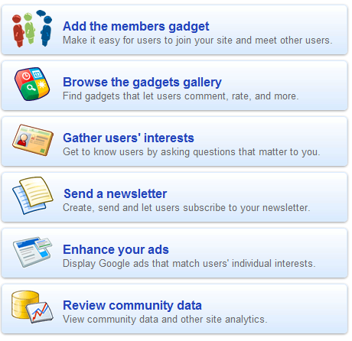
Google Friend Connect
Novel way to integrate Social Features
Allow users to login with existing Google, Yahoo, AOL, OpenID accounts

Slide 39
OAuth (cont.)
Drawbacks
V1.0 is vulnerable to session fixation attack (http://oauth.net/advisories/2009-1). Fixed in v1.0a.
Delegation granularity (Service provider-specific)
Operations
Data
Access token management
Non-standard
Expiration (implicit timeout)
Revocation (explicitly revoke assigned privileges)

Slide 40
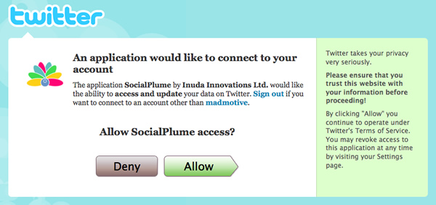
OAuth
Users’ data is served at service providers.
Third party apps want to access users’ data.
Users don’t need to relinquish username and password to third party apps.
3rd-party App
Twitter
Google Docs
MySpace Twitter
SmugMug

Slide 41
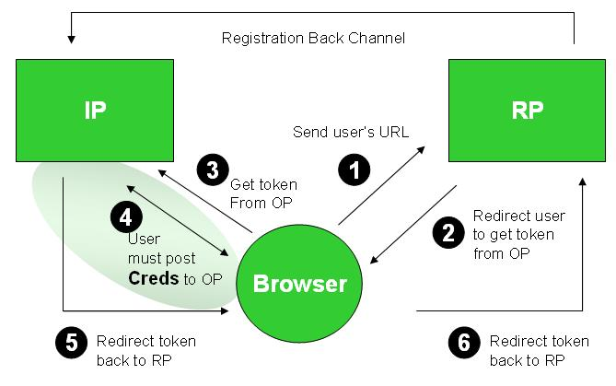
OpenID
Separation of Identity Provider and Relying Parties.
Identity Providers: Blogspot, Flickr,
Use the same OpenID to log in multiple sites.
Bind OpenID to local accounts.
After the binding, use OpenID for login.
Google Blogspot Yahoo! Flickr AOL
OGCE Gadget Portal

Slide 42
OpenSocial
A coherent open architecture designed for social network services and applications.
Components
Interface : REST, Javascript APIs
Client : Ajax, Gadget
Message Format : JSON, XML
Security : OAuth
Data Model

Slide 43
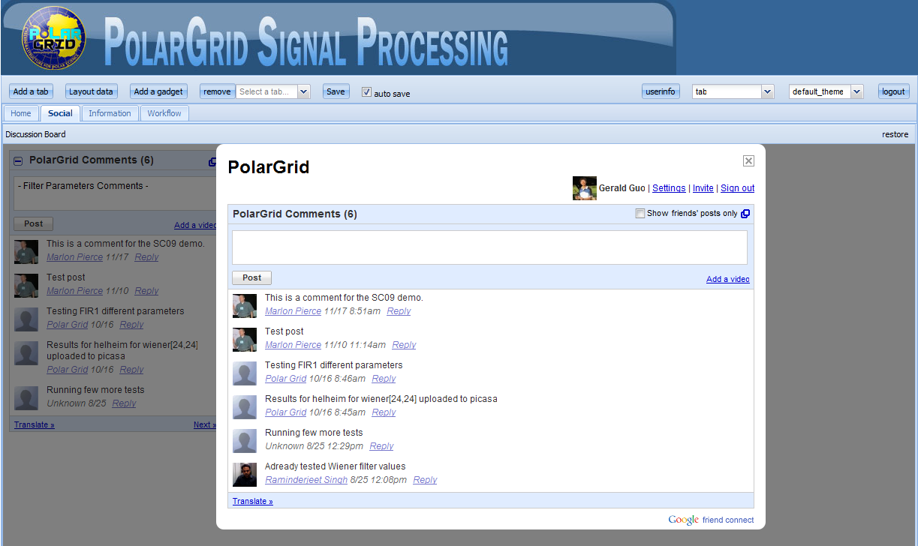
Polargrid Discussion Board Gadget

Slide 44
OGCE Funds Full Gateway Software Lifecyle

Slide 45
OGCE Partners and People
Institution | People
Indiana University | Marlon Pierce, Suresh Marru, Raminder Singh, Archit Kulshrestha, Gerald Guo
NCSA/UIUC | Sudhakar Pamidighantam, Shaowen Wang, Yan Liu
Purdue University | Carol Song, Lan Zhao, David Braun, Shawn Wu
UTHSCSA | Emre Brookes, Borries Demeler, Bruce Dubbs

