Slide 1
Open Applications Go Mobile
Andy Smith
Jason Roy Gary

Slide 2
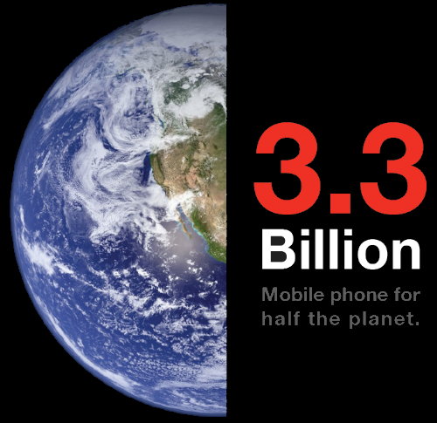
Mobile Phones and Devices

Slide 3
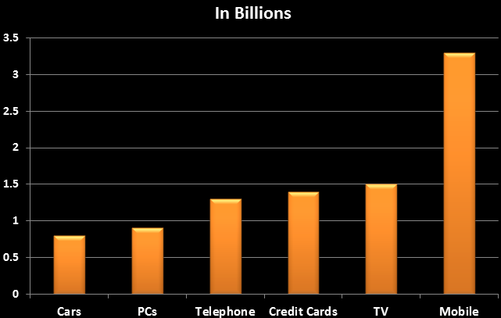

Slide 4
What We Wanted
There are multiple ways to take OpenSocial mobile, But:
Extensibility Across Provisioning Patterns
Reuse of Web Programming Model on Mobile
Reuse of Existing Assets
Support Sovereign Pivots and Context
Multiple Mobile Device Support Including Various Form Factors
Use Local Device Services

Slide 5
RoadTrip
High performing zero-install to hybrid framework (via chassis)
Seamless navigation across components
Fixed-position toolbar at the bottom
Scrolling support and Native “Like”
Orientation support for landscape and portrait modes
View adaptation for tablet form factor

Slide 6
More On Roadtrip
Next generation user experience and navigation model
Lazy loading of components to optimize initial download size
File compaction/minification to reduce total download size
Image spriting to reduce network latency and number of HTTP requests
Resource sharing to eliminate duplication of shared resources across individual gadgets
Native application integration
Contextual linking with native applications
Ability to save web application state when exiting to native application
Macro component model to contextually bind existing components
Device-peripheral integration
Ability through to access device camera, PIM, GPS, etc. through bridged technologies

Slide 7
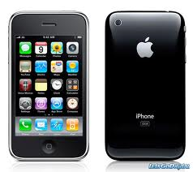
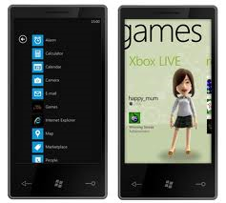
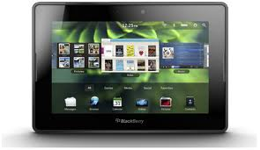
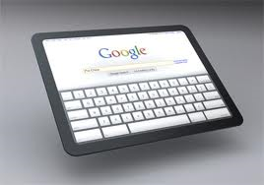
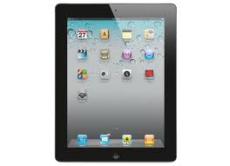
Devices
iPhone
iPad
RIM Blackberry OS6
Blackberry Playbook
Android Tablets
Android Phones
Windows 7 Phones

Slide 8
Fast?

Slide 9
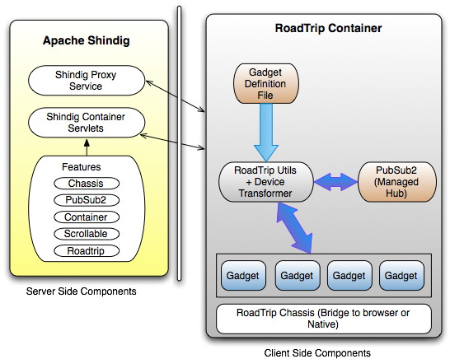
High-level Architecture
12-May-2011
#openapprevolution

Slide 10
The Chassis
An abstracted facade of API stubs made available to gadgets in order to interact with the device-specific peripherals and PIM facilities where available.
For example:
In the simplest/base case, it returns a <span> element wrapped around an <a> element with the href attribute having a value of tel://xxx-xxx-xxxx.
However, in an bridge-enabled environment such as BlackBerry Widgets/WebWorks, the markup returned contains an onclick attribute instead of the href in the <a> element that leverages the blackberry.invoke API to directly dial the provided number.
Any gadget making use of the roadtrip.chassis.getPhoneMarkup is shielded from the specifics involved in actually making the phone call, and instead can rely on a consistent API to always return the applicable markup based on the underlying environment.

Slide 11
Inter-Gadget Communication
gadgets.Hub.publish("com.ibm.cognos.report", message);
gadgets.Hub.subscribe("com.ibm.cognos.report", callback);
12-May-2011
#openapprevolution

Slide 12
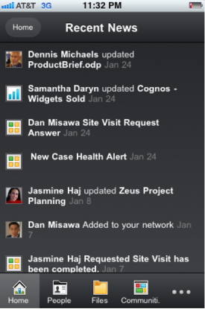
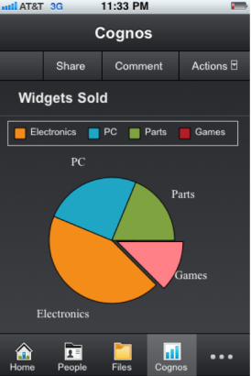
Layering Context - Pivot across apps
12-May-2011
#openapprevolution

Slide 13
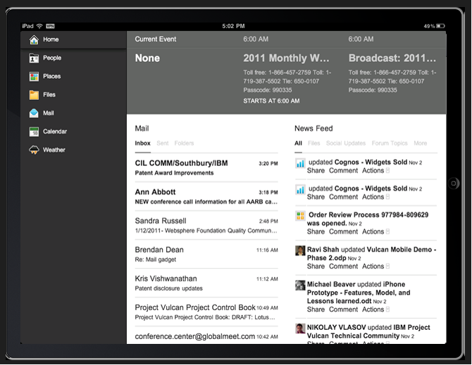
Let’s See Some Examples

Slide 14
Next Steps (.next)
Align mobile container
Common Container, Declarative Actions & Selection
Embedded Experience
Views
Prototype and explore spec changes to support consistency across containers
IBM will be Open Sourcing All of Roadtrip
Attend the Poster Session on Roadtrip
12-May-2011
#openapprevolution

Slide 15
Thank You
12-May-2011
#openapprevolution

