Slide 1
The State of the Union

Slide 2
Welcome
&
Introductions
Notes:
OS Foundation Board of Directors
Chris Cole – MySpace
Jason Gary – IBM
Jonathan LeBlanc – Yahoo!
Matt Tucker – Jive Software
Paul Lindner – Google
Evan Promodou – Community Representative
Mark Halvorson – Community Representative
Officers
Jonathan Beri – Treasurer
Helen Chen – Secretary

Slide 3
“THANKS!”
Notes:
Stand up if you are have
Committer on the spec project
Patched the spec
Participated in the google group
Stand up in you are:
A committer on Shindig
Contributed a patch to shindig
Special shout out:
Paul Lindner – Hosting us at Google
Andrew Davis – Poster Sessions

Slide 4
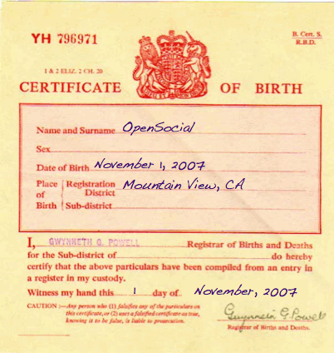
Notes:
Clearly, OpenSocial was born in the United States

Slide 5
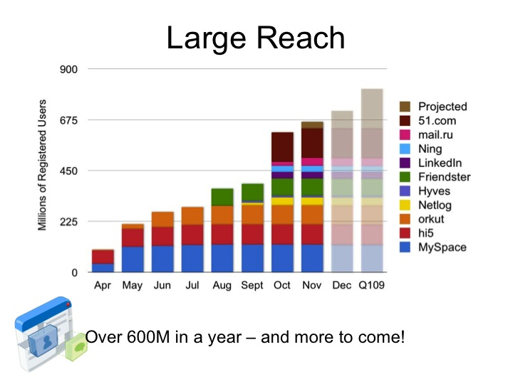
2008
Notes:
There was explosive growth in 2008 & 2009
In the CONSUMER space

Slide 6
2010
Notes:
2010 – The year of the enterprise
OpenSocial Europe!! (First Ever)
Open source enterprise platforms
Eureka Streams
eXo
Liferay

Slide 7
2010

Slide 8
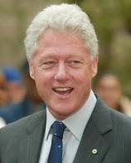
“It’s the economy, stupid.”

Slide 9
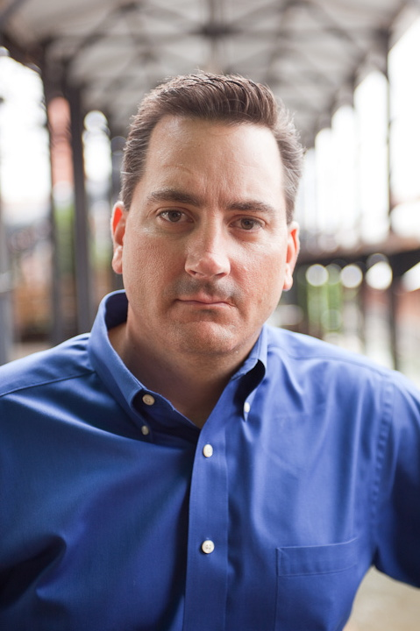
2011
“It’s open apps, stupid.”
Notes:
Snowclone

Slide 10
#openapprevolution
Notes:
Balance of power between platform provider and developers
OpenSocial is a tool to empower developers to influence and drive platform providers

Slide 11
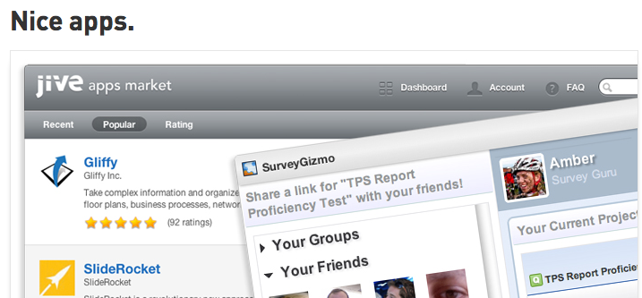
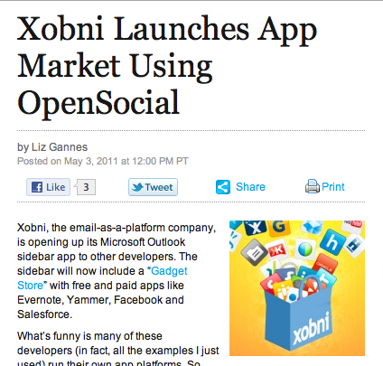
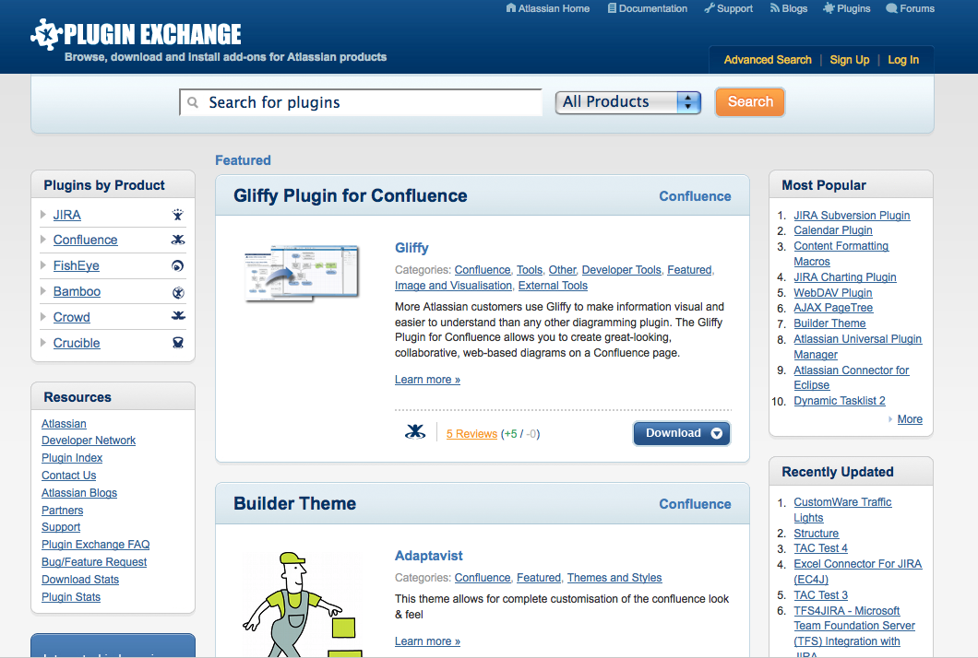
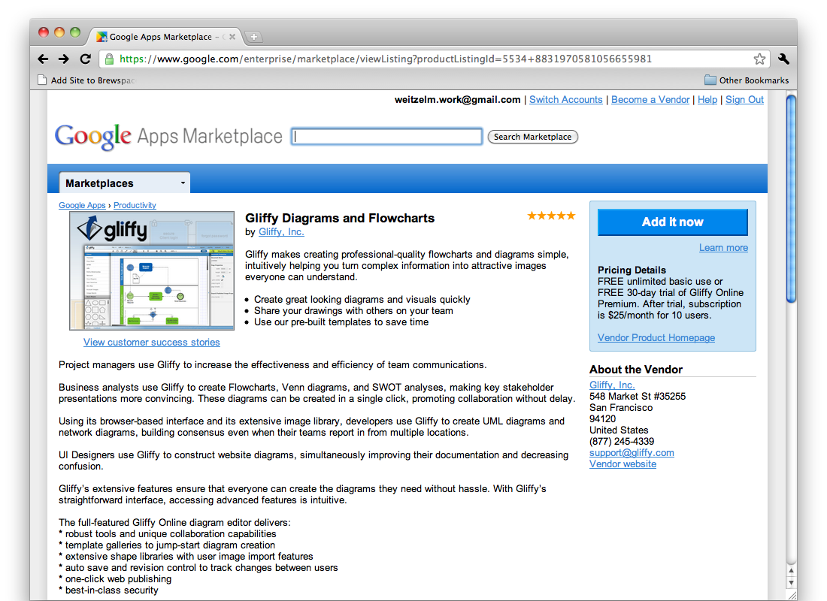
OpenSocial based App Markets

Slide 12
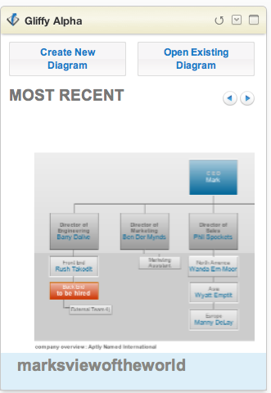
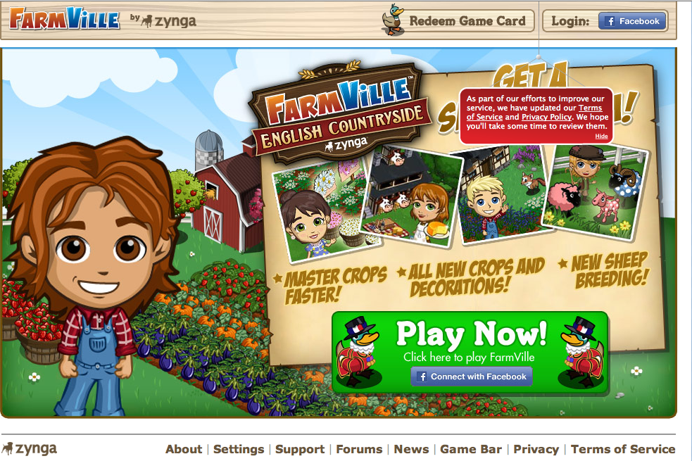
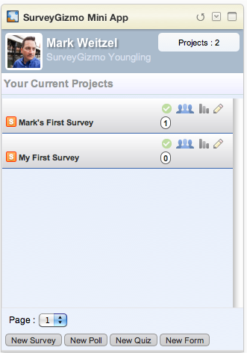

Slide 13
2.0

Slide 14
Notes:
The stream made zynga

Slide 16
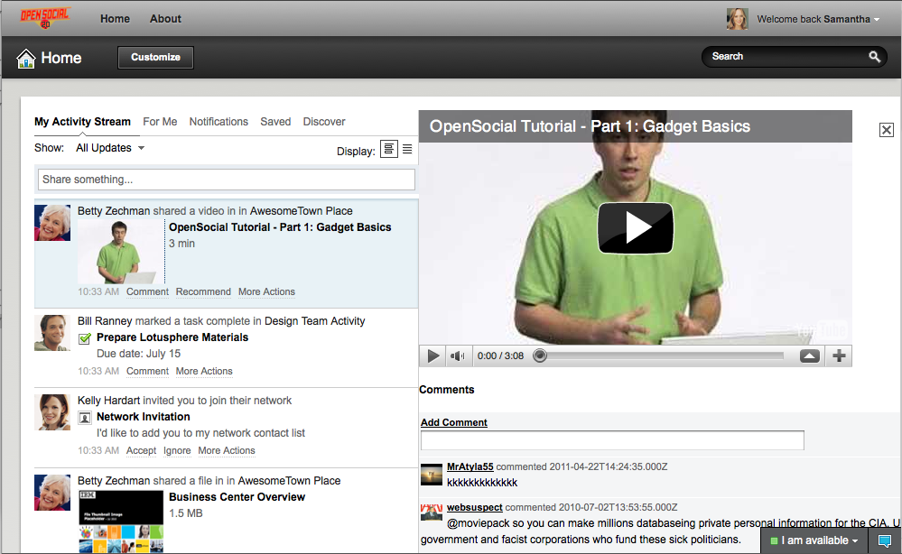
Embedded Experience

Slide 17
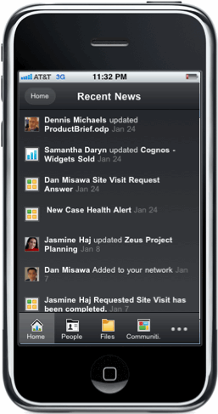
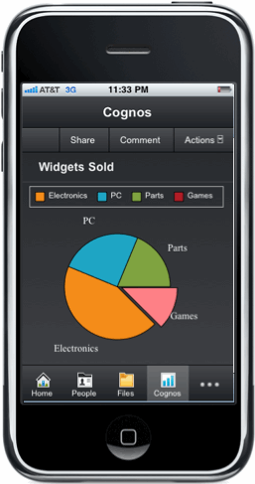
Notes:
Apps Everywhere

Slide 18
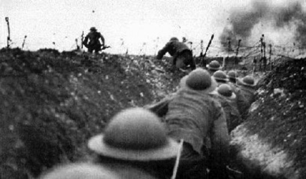
Dispatches from the front
Notes:
Technical Sessions
Paul Lindner: Shindig
Chris Cole: Templates, Data Pipelining, Expression Language
Matt Null: Building a cross container business app

Slide 19
Notes:
Introduce the Panel
Chris Kohlhart: Gliffy
Ryan Nichols: Appirio
Jeff Hotchkiss: Xobni
Mark Halvorson: Attlassian

Slide 20
BE A REVOLITIONARY!
Notes:
GET INVOLVED
We need the app perspective
Revolutionaries work together
Next year: 300 people

